Slide 1
Class 5: Graphing Data with Altair
MGSC 310
Ben Labaschin

Slide 2
Class 5: Outline
Grammar of Graphics
Plotting using Altair
Altair lab
👈

Slide 3
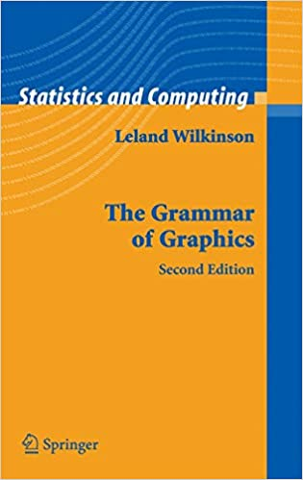
Language follows grammar
The boy hit the ball
S
V
O
Can graphics follow a grammar?

Slide 5
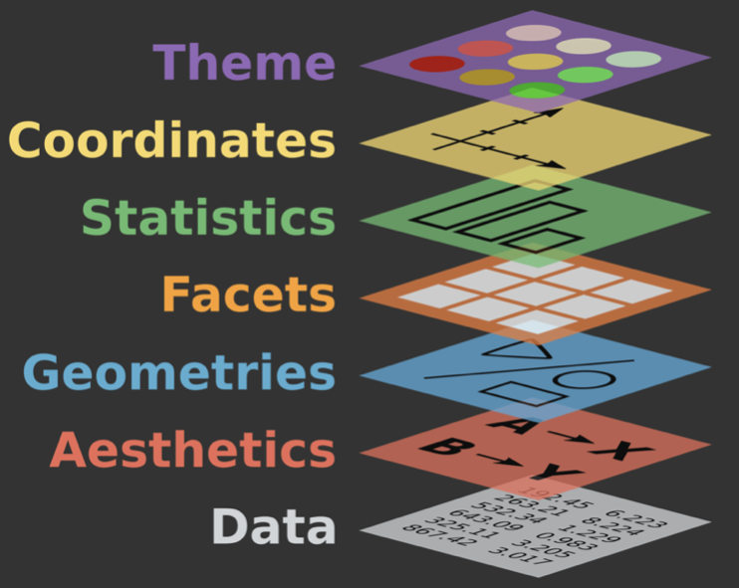
Seven grammar elements of every plot
Data: What is the data you want to visualize?
Aesthetics: What data will be on the x and y axes?
Geometry: What shapes (bars, lines, points) will you use to represent your data?
Facets: Will your data be split into multiple plots? If so, how?
Statistics: Will you use statistical summarizes on your data (e.g. smoothing lines)
Coordinates: What’s the numeric plotting space?
Themes: What is the visual identity (fonts, size, colors)?

Slide 6
Class 5: Outline
Grammar of Graphics
Plotting using Altair
Altair Lab
✔️
👈

Slide 7
But How Can We Implement This In Practice? To the Code!
Altair Colab

Slide 8
Class 5: Outline
Grammar of Graphics
Plotting using Altair
Altair Lab
✔️
✔️
👈

Slide 9
Class 5 Lab

